Slide 1
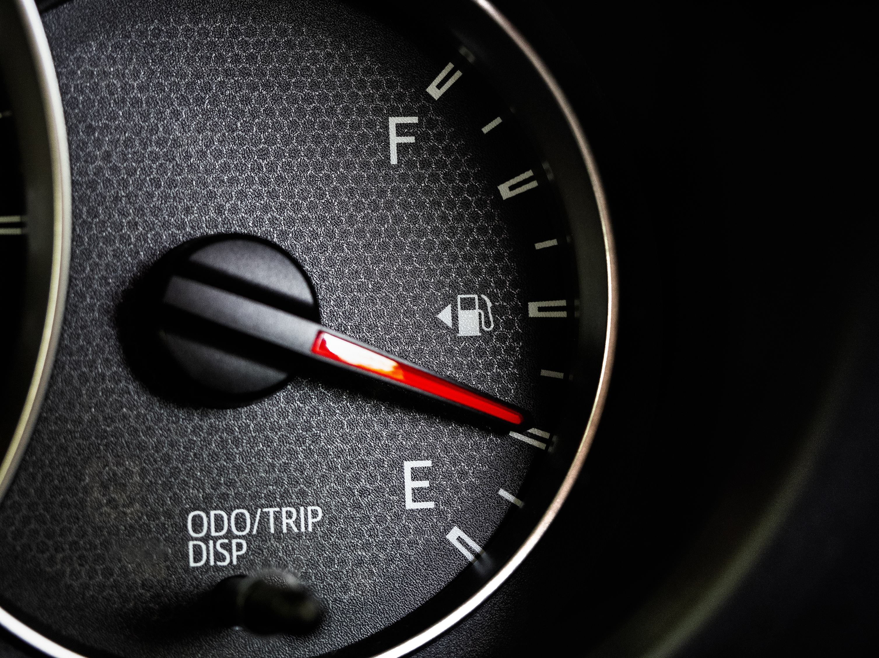

Predicting Car Fuel Efficiency
Kenyta Blount
CS 422

Slide 2

Problem
Type: Supervised Regression
Goal: Predict a car’s Miles per Gallon (MPG) using its characteristics.
Input features include engine size, horsepower, weight, and model year.
Why it matters: cost of fuel + environmental impact

Slide 3

Dataset
Dataset: UCI Auto MPG Dataset (398 samples)
392 cars (after cleaning)
Years: 1970-1982
Features: cylinders, displacement, horsepower, weight, acceleration, model year, origin
Target: MPG

Slide 4
Preprocessing
Removed rows with missing horsepower
Dropped text field: car name
Train/test split: 80%/20% (random_state=42)
Standardized numeric features (mean 0, std 1)

Slide 5
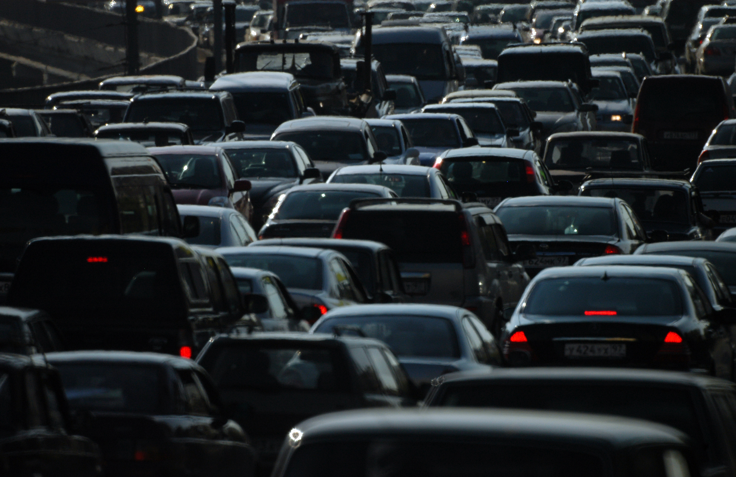
Method
Baseline: Always predict mean training MPG
k-Nearest Neighbors regression
Euclidean distance in scaled feature space
Tuned k ∈ {1,3,5,7,9,11,13,15}

Slide 6

Results
Baseline: MAE = 5.88, MSE = 51.62, R^2 = -0.01
Best k =3
Final kNN(k=3): MAE = 1.87, MSE = 7.16, R^2 = 0.86
Big improvement over baseline

Slide 7
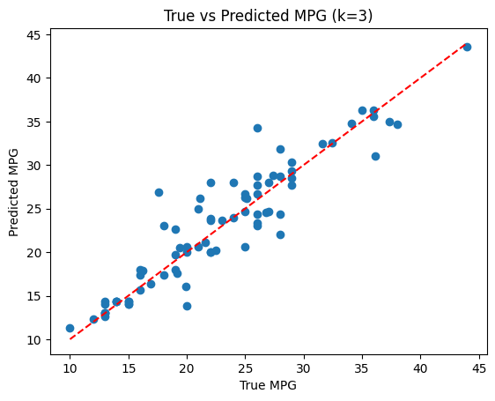
Plot (True vs Predicted)

Slide 8
References
UCI Machine Learning Repository — Auto MPG Dataset: https://archive.ics.uci.edu/ml/datasets/auto+mpg
Scikit-learn Documentation: https://scikit-learn.org/stable/
Kaggle Auto MPG Explorations

